Slide 1

GEAR COMP FINAL THREAD MISS
Model:K0PA
17th-Feb -2021
MUSASHI AUTO PARTS INDIA PVT. LTD.

Slide 2
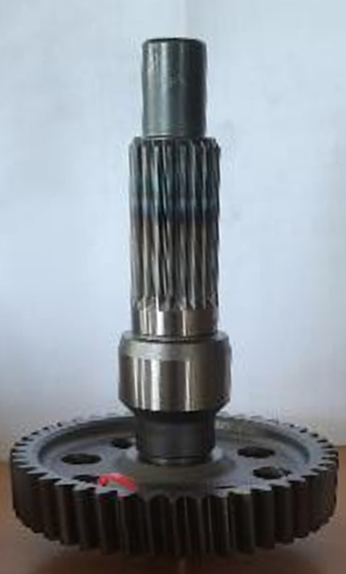
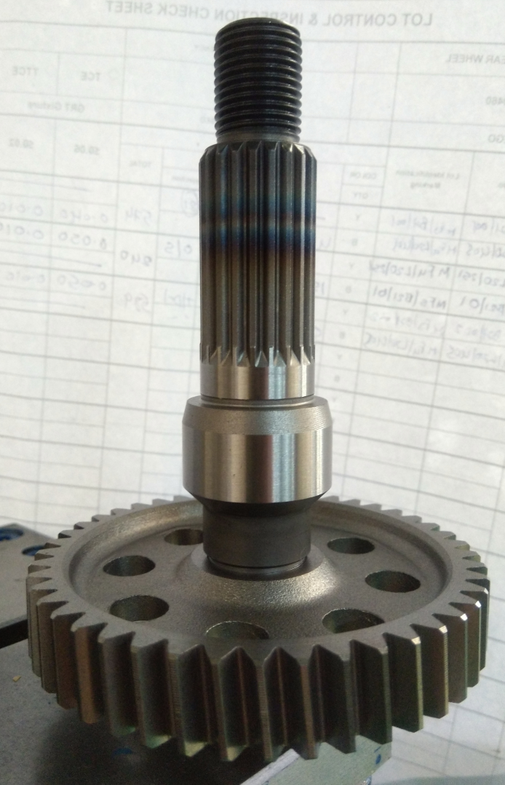
OVERVIEW
1. Overview | Parts Name :GEAR COMP, FINAL Model: K0PA
1-2. Number of Claims | 01 Vehicle
1-3.Occurance Lot No. | MAP Invoice No: 3196
1-4. Cause of Occurrence | Thread Operation Not available
1-4. Countermeasure Details | <Immediate Action ＞ 100% Parts checked Identify Process Verify-Occurrence and Outflow
1-5. Affected Range | 2412 Nos (Invoice No :3196)
Report Date:30.01.2021
Model: K0PA
Part: Gear Comp, Final
Thread Miss
Thread
OK
Segregation Details:
SLNO | LOCATION | Total QTY | Checked QTY | NG QTY
1 | HMSI-3F | 8300 | 8300 | 0
2 | FG | 4320 | 4320 | 0
3 | HT | 3700 | 3700 | 0
4 | Soft | 2050 | 2050 | 0
 | Total | 18370 | 18370 | 0

Slide 3
TRACEABILITY
Summary:
The Suspected Lot Produced in soft at 22.01.2021.
There is no Change Point Available on Particular Date.
Analysis to be done according to the Observations at Claim Part

Slide 4
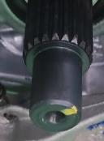
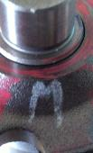
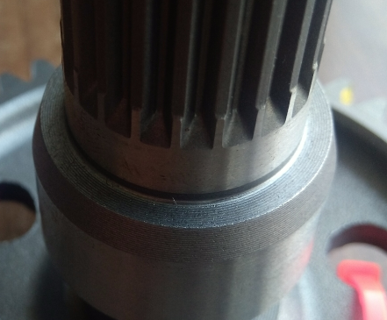
OBSERVATION
PHYSICAL OBSERVATIONS AT PART
CLAIM PART IMAGES
Parameter | Spec | Actual | Judgement | Remarks
Pre Roll Dia | 14.890~14.910 | 14.906 | OK | Thread Not Missed Due to Pre-Roll Dia Undersize
1
2
Other Observations:
SL No | OBSERVATION | INDICATION | RESULT
 | Yellow Mark at Shaft Face | Eddy Current Test Over | DEFECT SKIPPED
 | ’M’ Alphabet available on Gear Face | GRT Over, Associate Indication | GRT OK PART
 | No feed mark near Grinding Undercut | Line Identification | Line 1
1
2
3
3
DEFECT MAPPING BY PROCESS SEQUENCE
MATERIAL STORAGE
COLD FORGING
STRAIGHTENING
TURNING 1
TURNING 2
THREAD ROLLING
JIG SETTING
HEAT TREATMENT
Occurrence
EDDY CURRENT TESTING
ROLL TESTING
ASSY WITH GEAR
AXIS GRINDING
LASER MARKING
RUNOUT INSPECTION
THREAD ANNEALING
SHOT BLASTING
Outflow
OIL APPLICATION AND DISPATCH
Occurred at Thread Rolling
Outflow Miss Happened from Eddy Current Testing

Slide 5
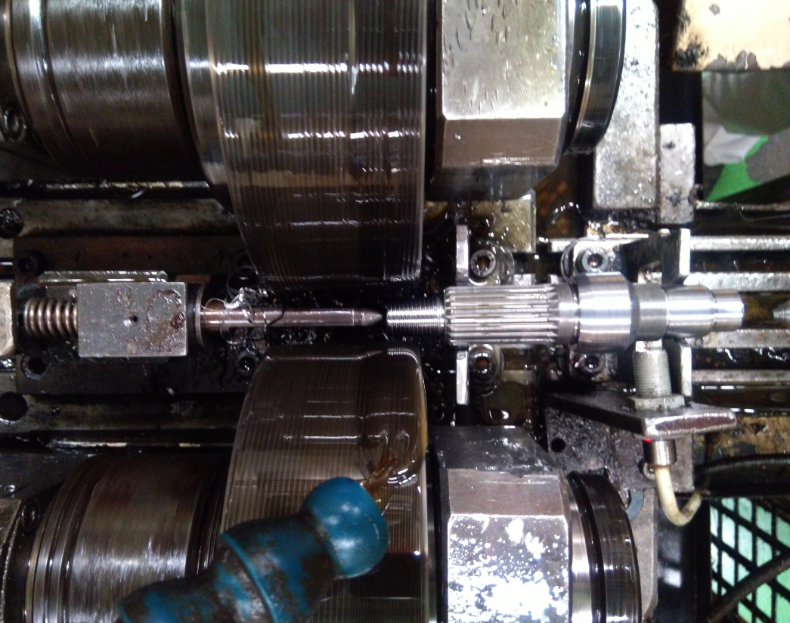
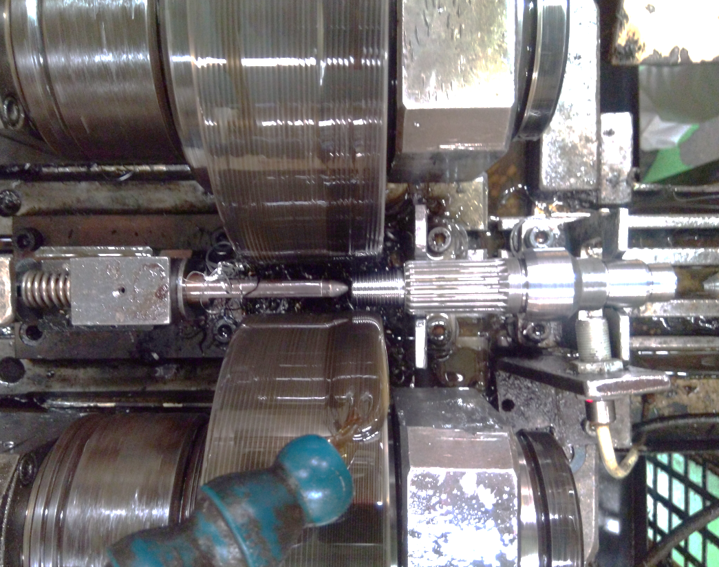
ANALYSIS-OCCURRENCE
FACTOR ANALYSIS
Sl No | POSSIBLE CAUSES | VERIFICATION | RESULT
1 | Dropped part miss handling | There is no dropped part recorded, there is no damage on the defect shaft | O
2 | Machine power cut | No power cut on that day | O
3 | Thread rolling part present sensor fault | Part present sensor working - incase of not working gantry don't run | O
4 | Thread head center sensor fault | Head center sensor working - incase of not working gantry don't run | O
5 | Mistake in Line Operation when Burr clearing from Thread Rolling Machine | Stops the line Manually to Remove the Burr and Thread miss Happens when restart the Line | X
6 | 1/50 measuring frequency not followed | 1/50 inspection followed as per frequency | O
7 | Alarm handling time Improper handling | No alarm generated on that day <In change point record> | O
8 | New manpower run the line | Manpower got skill according to Process requirement | O
Rollers
Burr
Burr from Turning 2, Which Swirl on the Stopper and Later can transfer to Rollers
What Happens If Burr present between part and Rollers?
Part
Due to Improper location of Part on Rollers Cycle will not be Started
Thread Miss Happens, when Manually Stops and Restarts Line for Burr Clearing

Slide 6
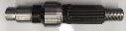



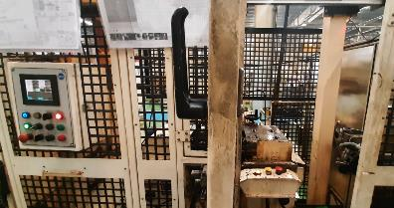
ANALYSIS- OCCURRENCE MECHANISM
I/P
Turning 1
Gantry
Turning 2
Gantry
Thread Rolling
O/P Jig
OK
Auto Operation From Input to Output
Ο
Man Intervention
Manual Break In Operation after Turning 2 for Burr Removal
Gantry Start
2
1
Manual Operation
Part Removal
Burr Cleaning Part Re Placing at Locator
Cycle Start
Gantry Start
Ο
Cycle Start
Man Intervention for Manual Operation of Parts in case of Burr Removal

Slide 7
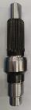
ANALYSIS- OCCURRENCE MECHANISM
Abnormal
Manual Break In Operation after Turning 2 for Burr Removal
1
❒
Manual Operation
Part Removal
Burr Cleaning
Part Re Placing at Locator
Cycle Start
Gantry Start
Mistake done when Re-Started the Line
Step | Why1 | Why2 | Why3 | Why4 | Why5
Occurrence | Thread operation miss happened after manual stop of Auto line | Gantry picked the part from Thread Rolling with out Threading Operation | After line reset, gantry started and picked without thread part | Gantry Picks the part even Thread Rolling ‘Cycle Start’ Not activated | Existing logic Allows The Gantry to Pick the part Before Thread Rolling ‘Cycle Start’
Logic Change to be Considered to avoid failures in Future

Slide 8
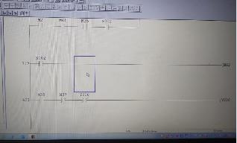
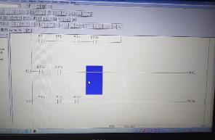
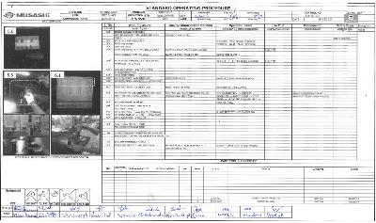
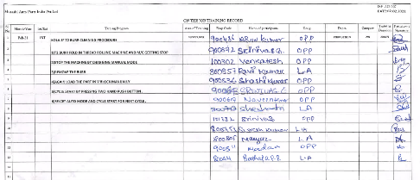
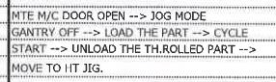
ACTIONS- OCCURRENCE
1.OCCURRENCE ROOT CAUSE |  | 1.OCCURRENCE COUNTERMEASURE |  | TARGET DATE | RESP. | STATUS
2B | Existing logic Allows The Gantry to Pick the part Before Thread Rolling ‘Cycle Start’ when Manual Stop and Restart | 2B | Gantry movement to be interlocked with thread rolling ‘Cycle start’ at manual restart also-(interlock logic: if cycle start not hit, gantry will not Pick the part from Thread Rolling) | 03/02/2021 | SURESH & NIJO | O
BEFORE
AFTER
Existing Logic: Gantry will Pick the Part from Thread rolling without Thread Roll ‘Cycle start’ also
Changed Logic: Gantry will Pick the Part from Thread only when Thread Roll ‘Cycle Start’ is Hit
Manual Part Handling SOP
OJT
Why Manual Stop Due to Long Burr ?

Slide 9

ACTIONS- HOW TO ELIMINATE BURR
Burr
Step | Why1 | Why2 | Why3 | Why4 | Why5
Occurrence | Line Manual stopped to correct the Abnormal Situation | Burr Present on the Thread Rolling Machine from Turning 2 | At Turning 2 Some Burr Swirls on the part and comes till Thread Rolling | Long Burrs available after Turning2 | Breaking of burr not happened
Target
Factors
Sub Factors
Actual
Judgement
Input Stock
Spec: 0.4~0.5
0.2
Ο
Breaking of Burr at Turning 2
As Per Spec
Ο
Parameters
Cutting Method
Tool
As per Spec
Ο
Roughing
No Long Burr
Ο
Tool Path
Finishing
Long Burr Present
∆
1.OCCURRENCE ROOT CAUSE |  | 1.OCCURRENCE COUNTERMEASURE |  | TARGET DATE | RESP. | STATUS
1A | In Roughing Cut Burr Generated | 1A | Dwell Time of 0.1 Sec Added in Roughing Cut | 03.02.2021 | Praveen, prabhu | O
Long Burr Avoided by Burr Breaking

Slide 10
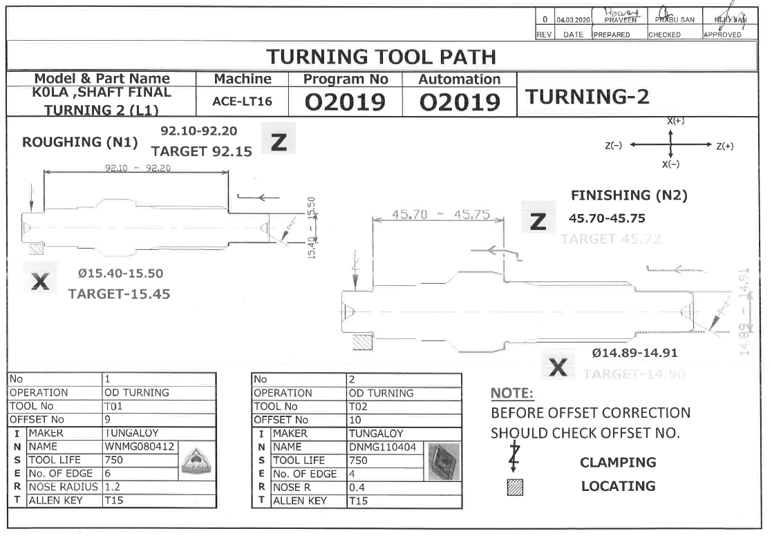
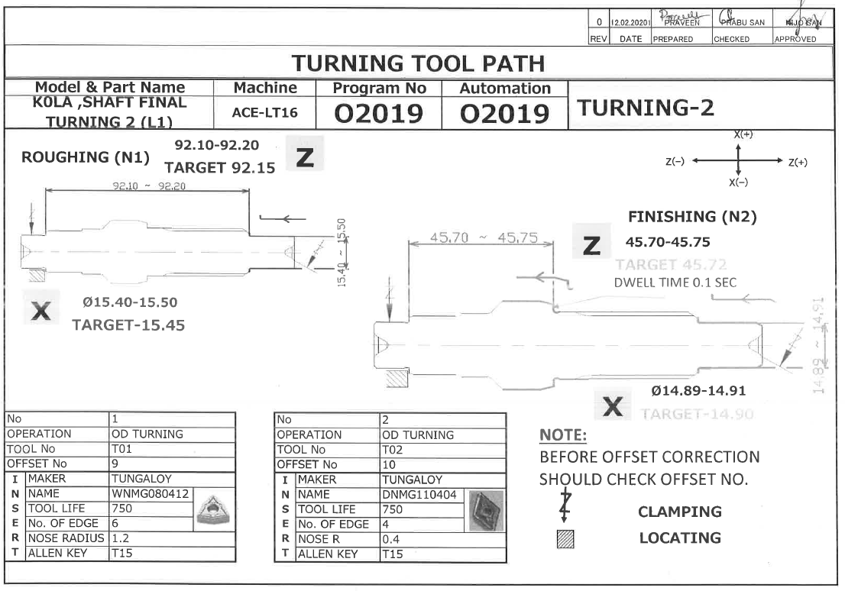
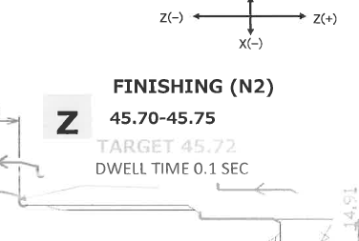
ACTIONS- EVIDENCE
BEFORE
AFTER
No Mention of Dwell Time in Before tool Path
Dwell time Added in Tool Path
Standardization done

Slide 11
ANALYSIS-OUTFLOW
POSSIBLE CAUSES | VERIFICATION | RESULT
Not detecting at eddy current | NG Part verified in Eddy Current Testing and found detecting | O
No buzzer or lamp after ng detection | Buzzer and lamp working properly | O
Ng detected part not treated as per ng handling procedure | NG part skip suspected as yellow mark available on the part | X
Man Skill to Identify NG Detection | ISHUWARA test Found OK | O
NG CONDITION
EDDY CURRENT TESTING
Test Result
Red Bin
Yellow Bin
Error Reset
Zero Setting
1
Part @ Test
2
Blue Bin
2
1
Part after Test
Input
Output
3
Part Kept on Tester
Previous Test OK Part Kept at Table
Test and Result
Marking on Previous Test NG Part also Marked OK
Cause:
Associate’s Confusion lead to Skip of NG Part

Slide 12
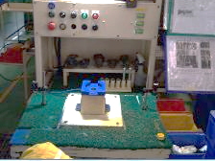
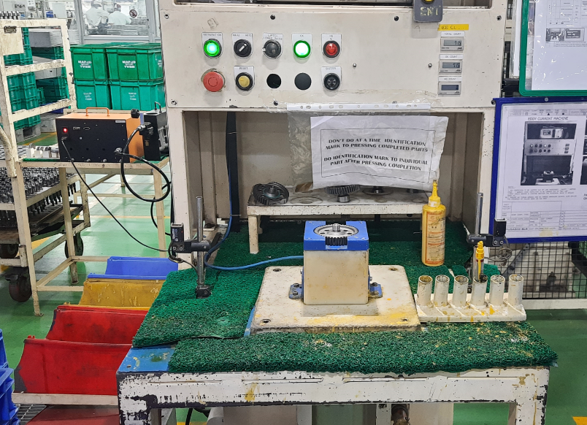
ACTION-OUTFLOW
Primary Cause
Root Cause
Action
Status
RYB Bins at Right Hand Side
1
Ο
RYB Bins Shifted To Left Side
Associate’s Confusion lead to Skip of NG Part
2
Ο
Improper Habit of Keeping Parts at Table After Test
Training given to Operator and SOP Updated
3
Ο
Eddy Current Flow Standardization
4
Counter Verification for NG part Detected V/s Actual
Ο
1
BEFORE
AFTER
3
AFTER
BEFORE
Input Part Pick
Part Pick
Keep at Table
Remove already Tested part
Remove already Test part
RYB Bins kept at Right Side of Operator (O/P Side)
RYB Bins Relocated to Left Side, Red Bin Kept near Hand
Keep at Table
Load Input For Testing
Load Input For Testing
Mark Early Tested Part
Mark Early Tested Part
Keep In Bin
Keep In Bin
Method Strengthening Done to Avoid Inspection Skip

Slide 13
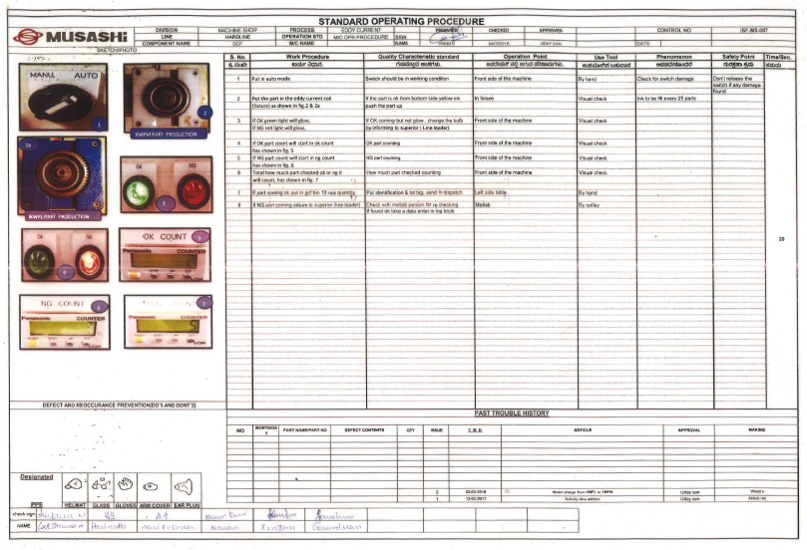
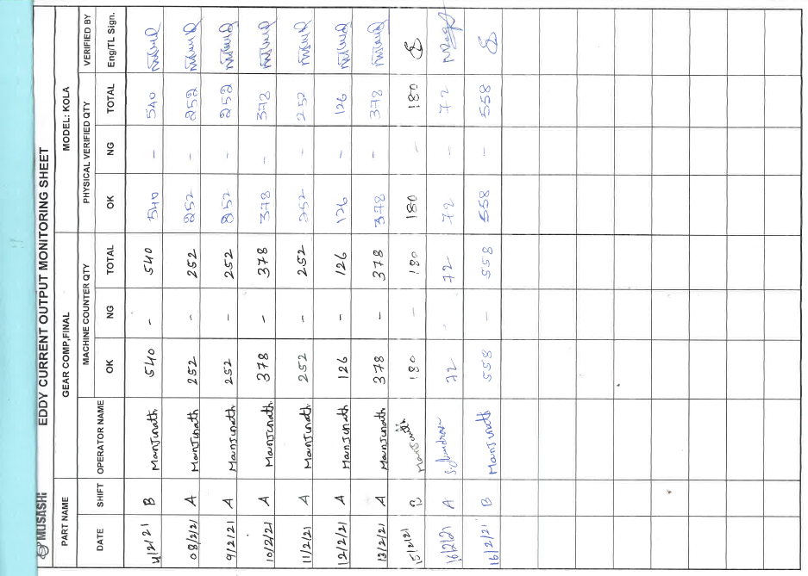
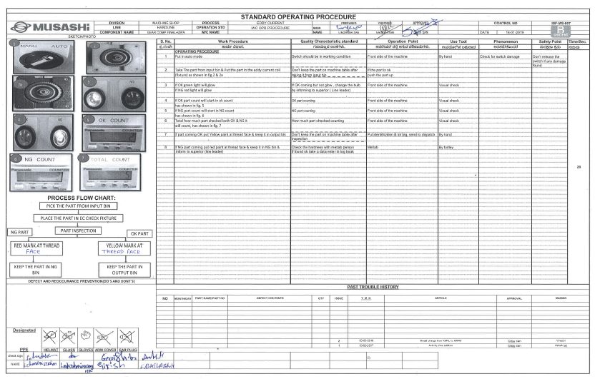
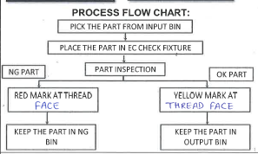
ACTION-OUTFLOW
3
BEFORE
4
Counter V/s Physical parts Verification
AFTER

Slide 14
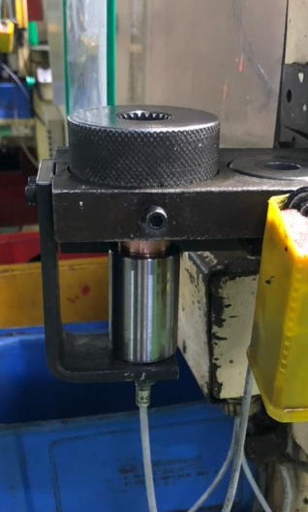
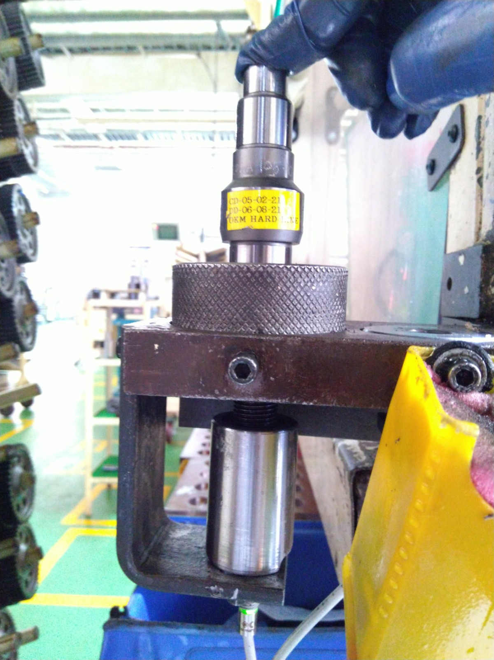
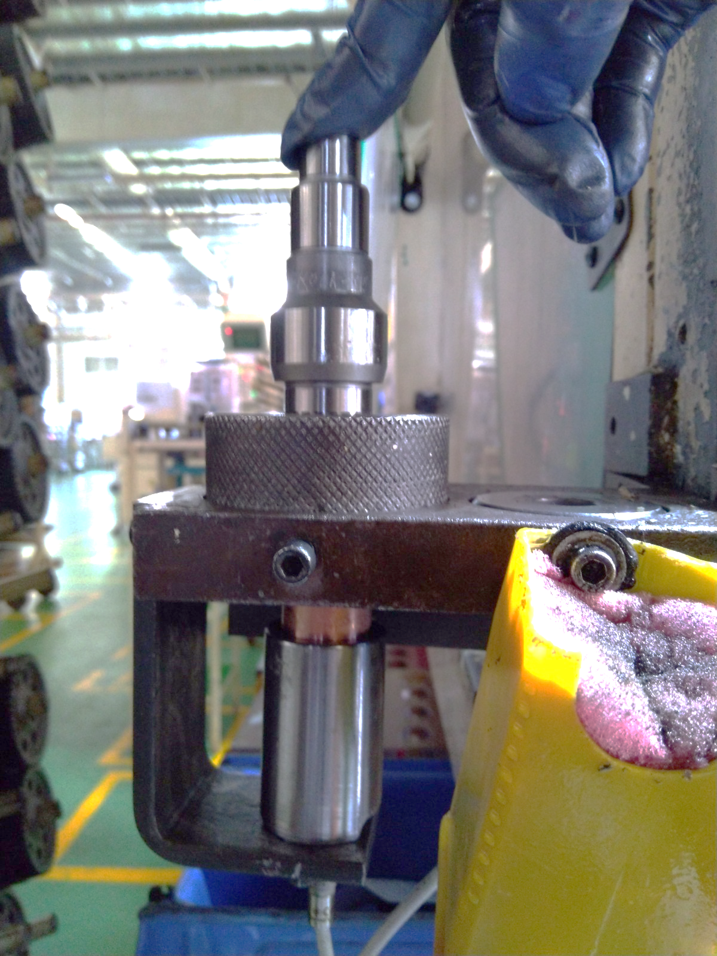
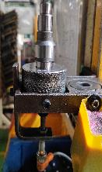
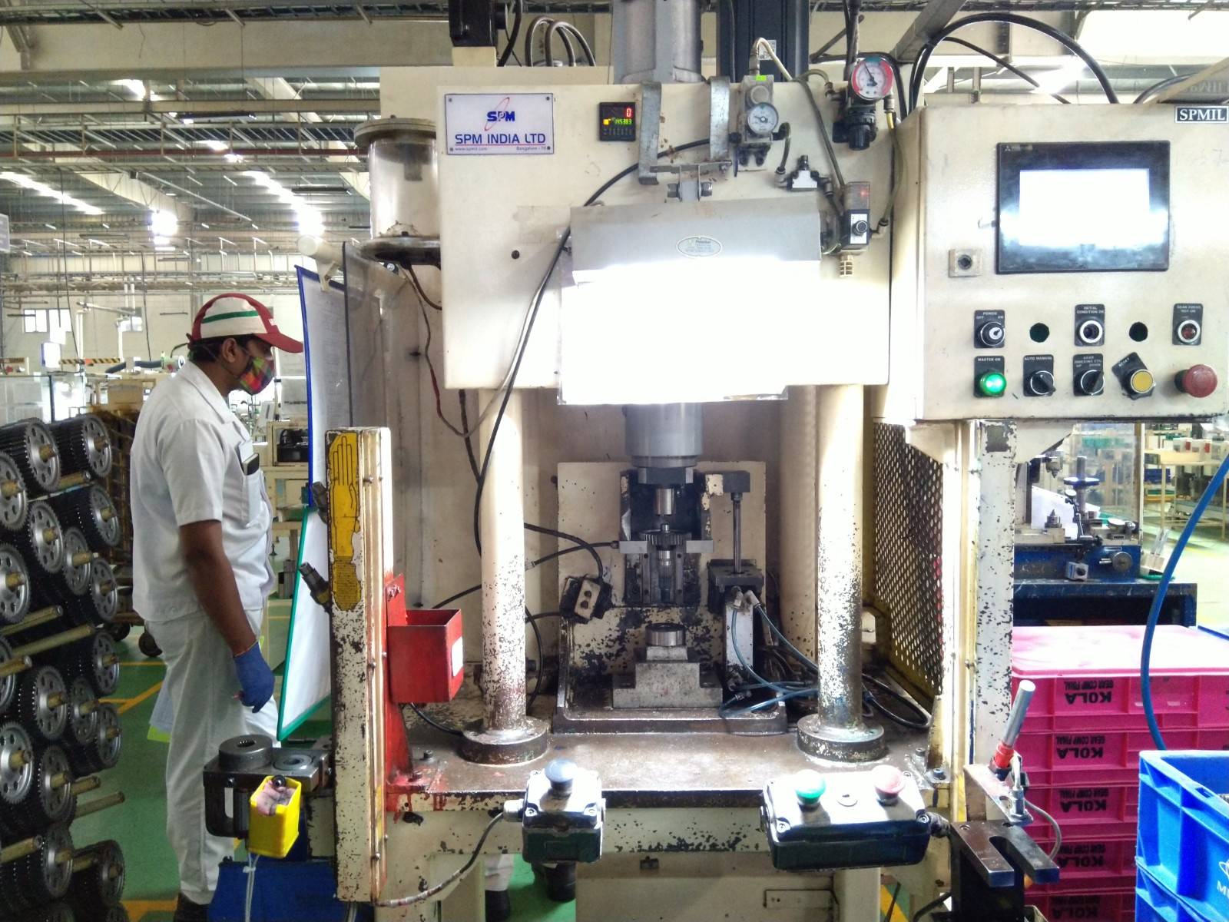
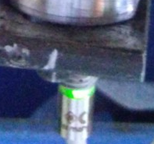

POKA YOKE TO PREVENT OUT FLOW TO EDDY CURRENT TESSTING
Type of Control :Poka Yoke
Process :Gear Pressing
Purpose: To Avoid Thread Miss Part outflow up to Eddy Current Testing
BEFORE
AFTER
POKA YOKE WORKING
With Thread Part
Without Thread Part
1
2
Only Spline Inspection
Thread Miss Poka Yoke Added
Pressing Process
1
2
Shaft
Moving Down
Will not Move
Spline Gauge
Sensing
Not Sensing
Thread Detection Unit
Gear
Thread Pushes the bush and get sensed,
Give signal to Pressing
Without Thread get inserted to Bush and No Sensing,
No Signal to Pressing
Thread Missing Detection Will be happening at Pressing So No Outflow up to Eddy Current Testing

Slide 15
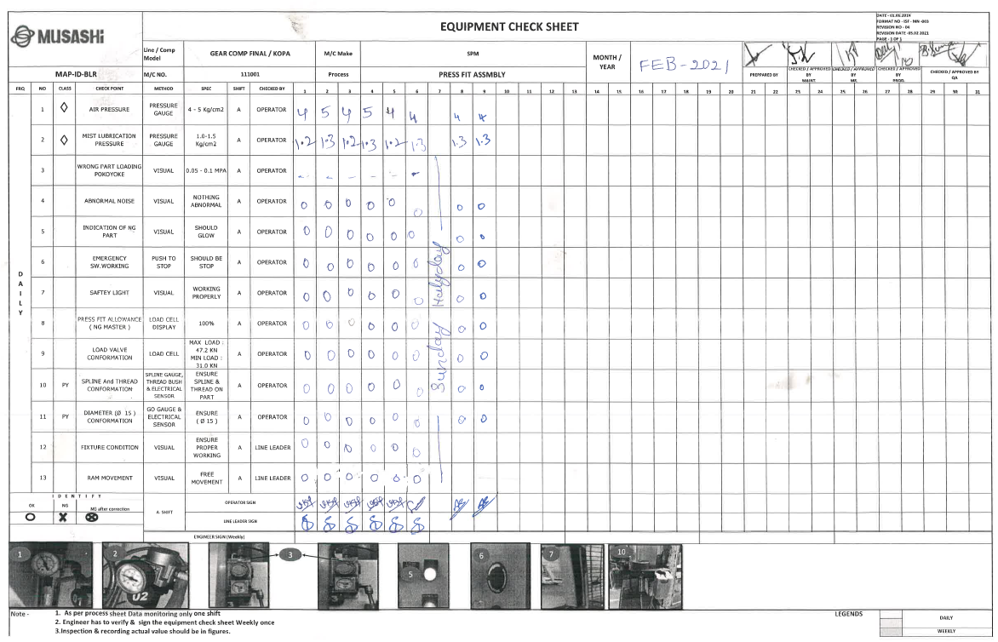
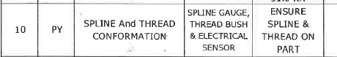
FOLLOW UP
STANDARDIZATION
EFFECTIVENESS
Zero Report Till Date
Claim Part
Action
Zero Report Till Date
Action
Same Action Implemented at Line 2 Also
Effectiveness found OK after Actions

Slide 16
Thank You

